Slide 1

Advanced Topics in Economic Evaluation and Healthcare
Lecture #8: Value of Information Analysis

Slide 2
Lecture Overview
In this lecture we will discuss:
  The Valuation of Diagnostic Tests
  A Non Technical Overview of The Expected Value of Perfect Information (EVPI)
  A Technical Overview of EVPI and Expected Value of Perfect Parameter Information (EVPPI)
  EVPI Curves.
  A Model free Approach to EVPI and EVPI is the same as the value of “minimized regret”.
By the end of this lecture we will understand what value of information analysis is, appreciate its theoretical grounding and how to compute it practically.

Slide 3

The Valuation of Diagnostic Tests.
Diagnostic tests are not therapeutic.
They do not improve an individual's health state.
However, they can inform treatment decisions.
Today we address: what is the value of perfect test which resolves some or all uncertainty about a patients health status,

Slide 4
A “Non Technical” Overview of The Expected Value of Perfect Information

Slide 5

Not all information is worth the price.
Suppose we are playing a game of heads or tails.
If you pick the right face, before the coin lands, you win 1 dollar if you pick the wrong face you lose 1 dollar.
The expected payoff is 50 cents under normal rules.
Both Heads and Tails are equally good choices.

Slide 6

Not all information is worth the price.
Suppose now instead of taking a bet at the start of the game, you observe the coin landing and then must choose.
That is you observe the “true state of nature” and then decide what the best choice is.
HERE YOU WILL ALWAYS WIN BECAUSE YOU SEE IF THE COIN IS HEADS OR TAILS BEFORE CHOOSING.
Question: How much are you willing to pay for a game with this new set of rules?

Slide 7
Not all information is worth the price.
Suppose now instead of taking a bet at the start of the game, you observe the coin landing and then must choose.
That is you observe the “true state of nature” and then decide what the best choice is.
HERE YOU WILL ALWAYS WIN BECAUSE YOU SEE IF THE COIN IS HEADS OR TAILS BEFORE CHOOSING.
Question: How much are you willing to pay for a game with this new set of rules?
YOU WILL NOT PAY MORE THAN A DOLLAR FOR
THIS NEW SET OF RULES

Slide 8
The Expected Value of Perfect Information

Slide 9
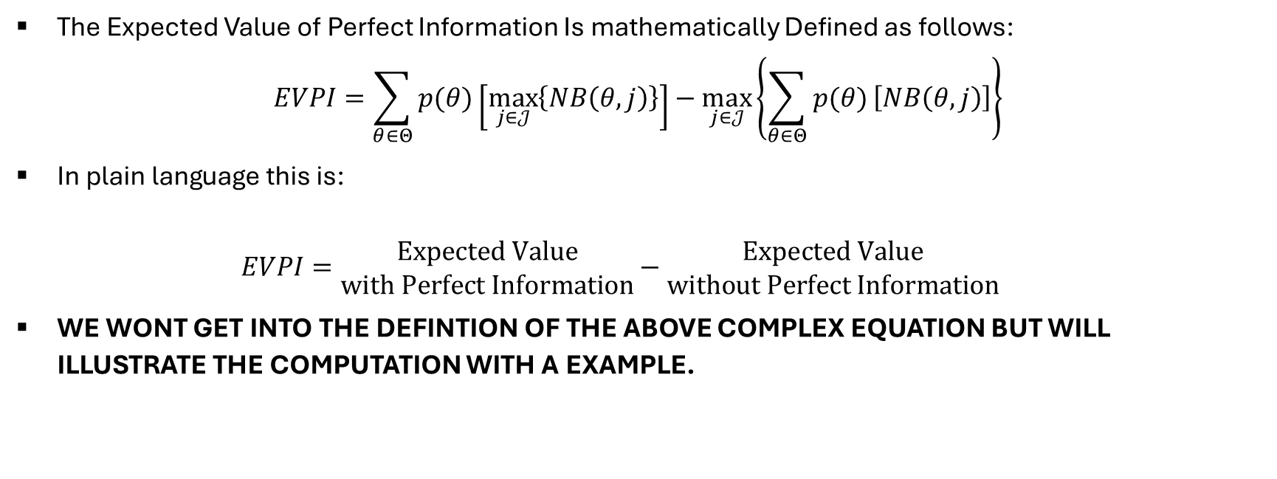
The Expected Value of Perfect Information.
The Expected Value of Perfect Information Is mathematically Defined as follows:
$EVPI=\sum_{θ∈Θ}{p(θ)}\left[\max_{j∈𝒥}\left\{NB\left(θ,j\right)\right\}\right]−\max_{j∈𝒥}\left\{\sum_{θ∈Θ}{p(θ)}\left[NB\left(θ,j\right)\right]\right\}$
In plain language this is:
$EVPI=\begin{matrix}Expected Value \\ with Perfect Information\end{matrix}−\begin{matrix}Expected Value \\ without Perfect Information\end{matrix}$
WE WONT GET INTO THE DEFINTION OF THE ABOVE COMPLEX EQUATION BUT WILL ILLUSTRATE THE COMPUTATION WITH A EXAMPLE.

Slide 10
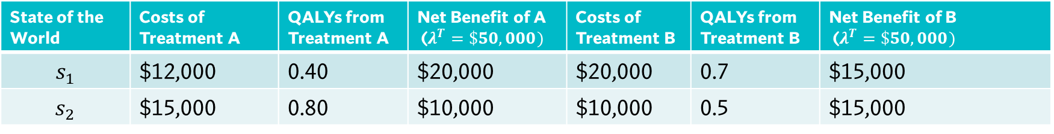
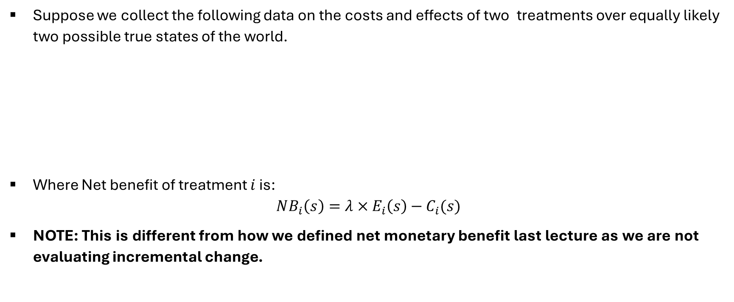
An Example from a Data Table
Suppose we collect the following data on the costs and effects of two treatments over equally likely two possible true states of the world.
Where Net benefit of treatment $i$ is:
$NB_{i}\left(s\right)=λ×E_{i}\left(s\right)−C_{i}(s)$
NOTE: This is different from how we defined net monetary benefit last lecture as we are not evaluating incremental change.
State of the World | Costs of Treatment A | QALYs from Treatment A | Net Benefit of A ($λ^{T}=\$50,000)$ | Costs of Treatment B | QALYs from Treatment B | Net Benefit of B ($λ^{T}=\$50,000)$
$$s_{1}$$ | $12,000 | 0.40 | $20,000 | $20,000 | 0.7 | $15,000
$$s_{2}$$ | $15,000 | 0.80 | $10,000 | $10,000 | 0.5 | $15,000

Slide 11
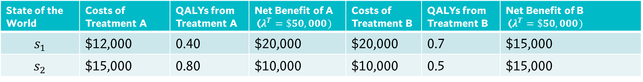
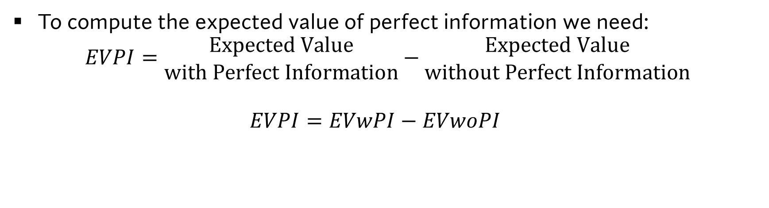
An Example from a Data Table
State of the World | Costs of Treatment A | QALYs from Treatment A | Net Benefit of A ($λ^{T}=\$50,000)$ | Costs of Treatment B | QALYs from Treatment B | Net Benefit of B ($λ^{T}=\$50,000)$
$$s_{1}$$ | $12,000 | 0.40 | $20,000 | $20,000 | 0.7 | $15,000
$$s_{2}$$ | $15,000 | 0.80 | $10,000 | $10,000 | 0.5 | $15,000
To compute the expected value of perfect information we need:
$EVPI=\begin{matrix}Expected Value \\ with Perfect Information\end{matrix}−\begin{matrix}Expected Value \\ without Perfect Information\end{matrix}$
$EVPI=EVwPI−EVwoPI$

Slide 12
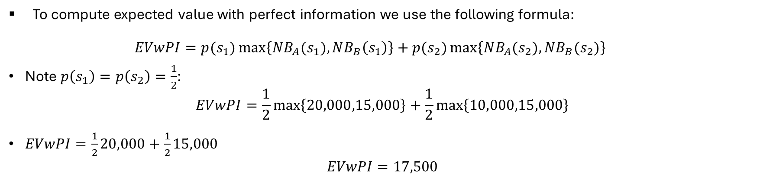
An Example from a Data Table
State of the World | Costs of Treatment A | QALYs from Treatment A | Net Benefit of A ($λ^{T}=\$50,000)$ | Costs of Treatment B | QALYs from Treatment B | Net Benefit of B ($λ^{T}=\$50,000)$
$$s_{1}$$ | $12,000 | 0.40 | $20,000 | $20,000 | 0.7 | $15,000
$$s_{2}$$ | $15,000 | 0.80 | $10,000 | $10,000 | 0.5 | $15,000
To compute expected value with perfect information we use the following formula:
$EVwPI=p(s_{1})\max\left\{NB_{A}(s_{1}),NB_{B}\left(s_{1}\right)\right\}+p(s_{2})\max\left\{NB_{A}(s_{2}),NB_{B}(s_{2})\right\}$
Note $p\left(s_{1}\right)=p\left(s_{2}\right)=\frac{1}{2}$:
$EVwPI=\frac{1}{2}\max\left\{20,000,15,000\right\}+\frac{1}{2}\max\left\{10,000,15,000\right\}$
$EVwPI=\frac{1}{2}20,000+\frac{1}{2}15,000$
$EVwPI=17,500$

Slide 13
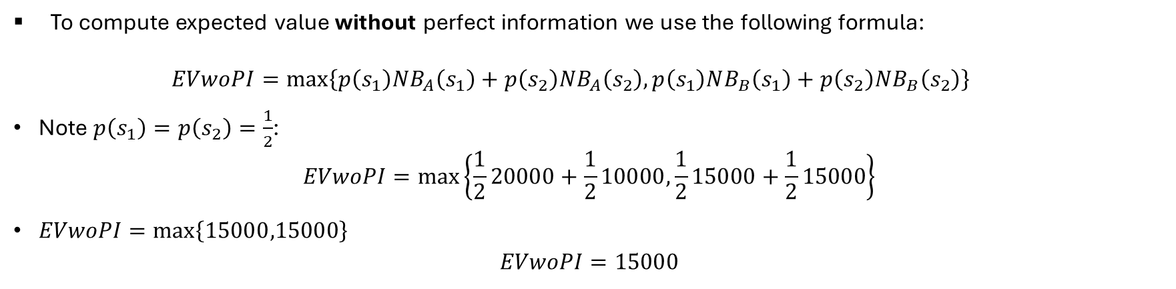
An Example from a Data Table
State of the World | Costs of Treatment A | QALYs from Treatment A | Net Benefit of A ($λ^{T}=\$50,000)$ | Costs of Treatment B | QALYs from Treatment B | Net Benefit of B ($λ^{T}=\$50,000)$
$$s_{1}$$ | $12,000 | 0.40 | $20,000 | $20,000 | 0.7 | $15,000
$$s_{2}$$ | $15,000 | 0.80 | $10,000 | $10,000 | 0.5 | $15,000
To compute expected value without perfect information we use the following formula:
$EVwoPI=\max\left\{p\left(s_{1}\right)NB_{A}\left(s_{1}\right)+p\left(s_{2}\right)NB_{A}\left(s_{2}\right),p\left(s_{1}\right)NB_{B}\left(s_{1}\right)+p\left(s_{2}\right)NB_{B}\left(s_{2}\right)\right\}$
Note $p\left(s_{1}\right)=p\left(s_{2}\right)=\frac{1}{2}$:
$EVwoPI=\max\left\{\frac{1}{2}20000+\frac{1}{2}10000,\frac{1}{2}15000+\frac{1}{2}15000\right\}$
$EVwoPI=\max\left\{15000,15000\right\}$
$EVwoPI=15000$

Slide 14
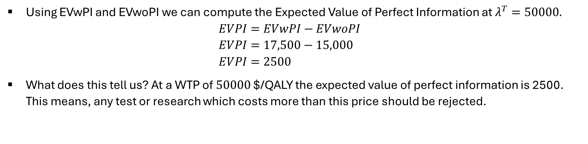
An Example from a Data Table
State of the World | Costs of Treatment A | QALYs from Treatment A | Net Benefit of A ($λ^{T}=\$50,000)$ | Costs of Treatment B | QALYs from Treatment B | Net Benefit of B ($λ^{T}=\$50,000)$
$$s_{1}$$ | $12,000 | 0.40 | $20,000 | $20,000 | 0.7 | $15,000
$$s_{2}$$ | $15,000 | 0.80 | $10,000 | $10,000 | 0.5 | $15,000
Using EVwPI and EVwoPI we can compute the Expected Value of Perfect Information at $λ^{T}=50000.$
$EVPI=EVwPI−EVwoPI$
$EVPI=17,500−15,000$
$EVPI=2500$
What does this tell us? At a WTP of $50000$ $/QALY the expected value of perfect information is 2500. This means, any test or research which costs more than this price should be rejected.

Slide 15
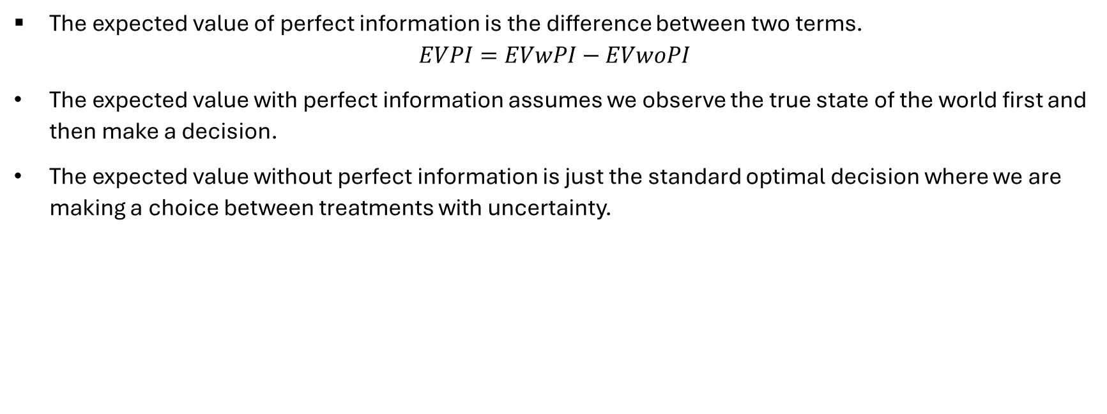
What EVPI is really
The expected value of perfect information is the difference between two terms.
$$EVPI=EVwPI−EVwoPI$$
The expected value with perfect information assumes we observe the true state of the world first and then make a decision.
The expected value without perfect information is just the standard optimal decision where we are making a choice between treatments with uncertainty.

Slide 16

WARNING
The Next Couple of Slides May Be More Technical Than Needed!

Slide 17
The Expected Value of Perfect Information visualized in Decision Trees
A Technical Overview

Slide 18
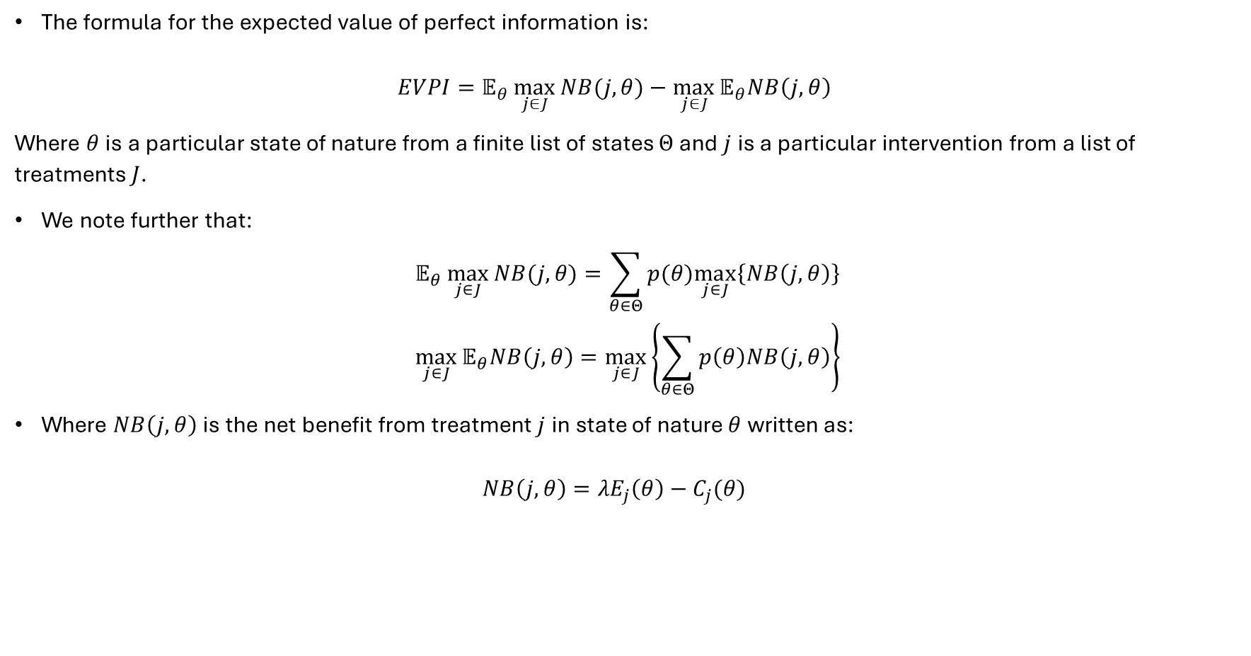
What is the Expected Value of Perfect Information?
The formula for the expected value of perfect information is:
$EVPI=𝔼_{θ}\max_{j∈J}{NB(j,θ)}−\max_{j∈J}{𝔼_{θ}NB\left(j,θ\right)}$
Where $θ$ is a particular state of nature from a finite list of states $Θ$ and $j$ is a particular intervention from a list of treatments $J$.
We note further that:
$$𝔼_{θ}\max_{j∈J}{NB(j,θ)}=\sum_{θ∈Θ}{p(θ)\max_{j∈J}\left\{NB\left(j,θ\right)\right\}}$$
$$\max_{j∈J}{𝔼_{θ}NB\left(j,θ\right)}=\max_{j∈J}\left\{\sum_{θ∈Θ}{p\left(θ\right)NB\left(j,θ\right)}\right\}$$
Where $NB\left(j,θ\right)$ is the net benefit from treatment $j$ in state of nature $θ$ written as:
$NB\left(j,θ\right)=λE_{j}\left(θ\right)−C_{j}(θ)$

Slide 19





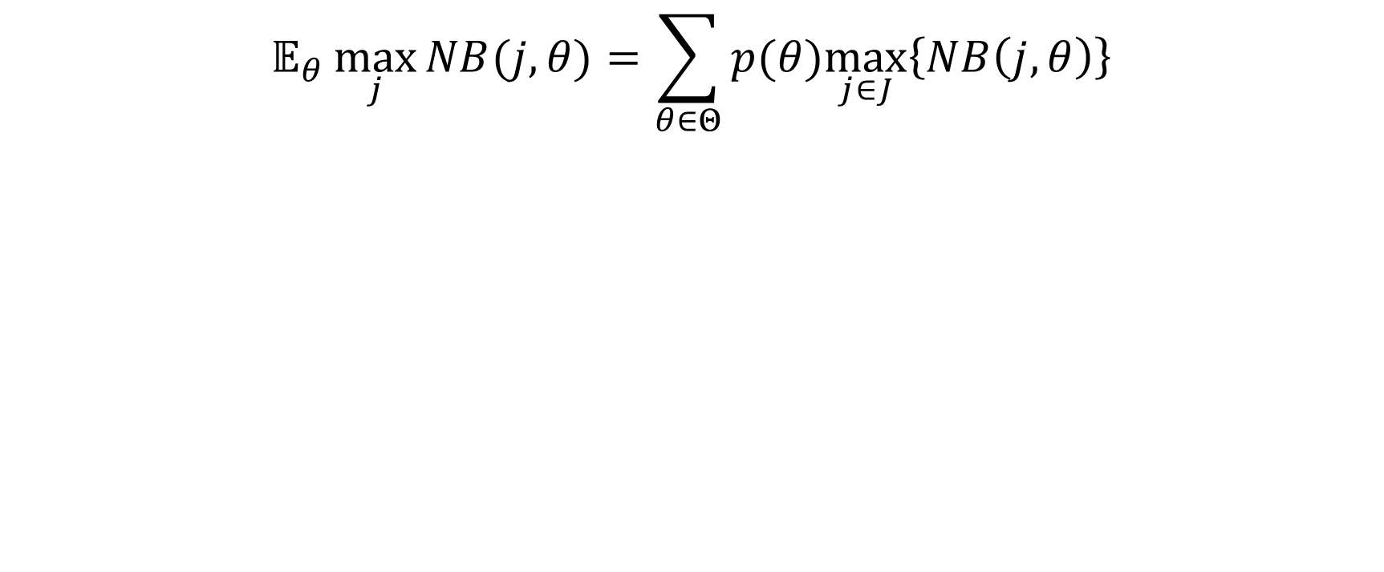

Expected Value with Perfect Information
$$𝔼_{θ}\max_{j}{NB(j,θ)}=\sum_{θ∈Θ}{p(θ)\max_{j∈J}\left\{NB\left(j,θ\right)\right\}}$$
Treatment 1
$$NB\left(1,1\right)=λE_{11}−C_{11}$$
$$p(θ=1)$$
What is the average payoff if we best respond in every state of nature?
Treatment 2
$$NB\left(2,1\right)=λE_{21}−C_{21}$$
Treatment 1
$$NB\left(1,2\right)=λE_{12}−C_{12}$$
$$p(θ=2)$$
Treatment 2
$$NB\left(2,2\right)=λE_{22}−C_{22}$$

Slide 20




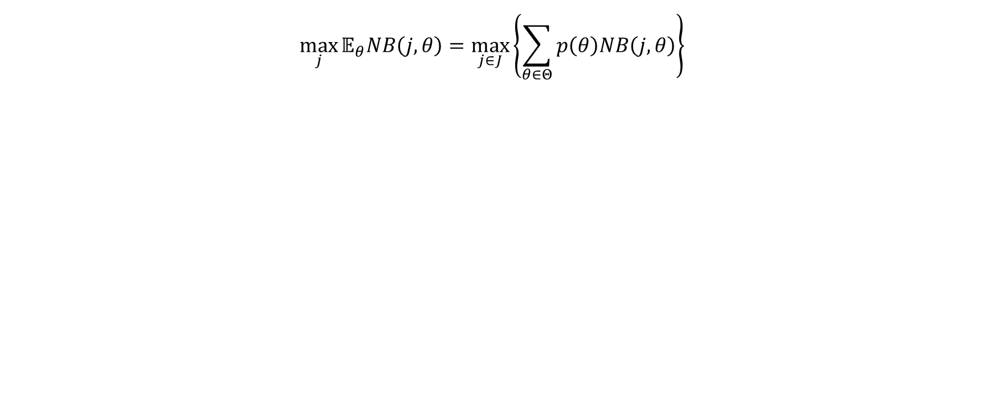



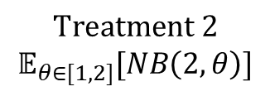
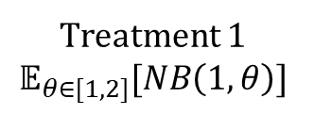

Expected Value without Perfect Information
$$\max_{j}{𝔼_{θ}NB\left(j,θ\right)}=\max_{j∈J}\left\{\sum_{θ∈Θ}{p\left(θ\right)NB\left(j,θ\right)}\right\}$$
$$p(θ=1)$$
$$NB\left(1,1\right)=λE_{11}−C_{11}$$
This is simply just communicating that we pick
the treatment with the maximum expected
net benefit
Treatment 1
$$𝔼_{θ∈[1,2]}[NB\left(1,θ\right)]$$
$$p(θ=2)$$
$$NB\left(1,2\right)=λE_{21}−C_{21}$$
$$p(θ=1)$$
$$NB\left(2,1\right)=λE_{12}−C_{12}$$
$$Treatment 2$$
$$𝔼_{θ∈[1,2]}[NB\left(2,θ\right)]$$
$$p(θ=2)$$
$$NB\left(2,2\right)=λE_{22}−C_{22}$$

Slide 21
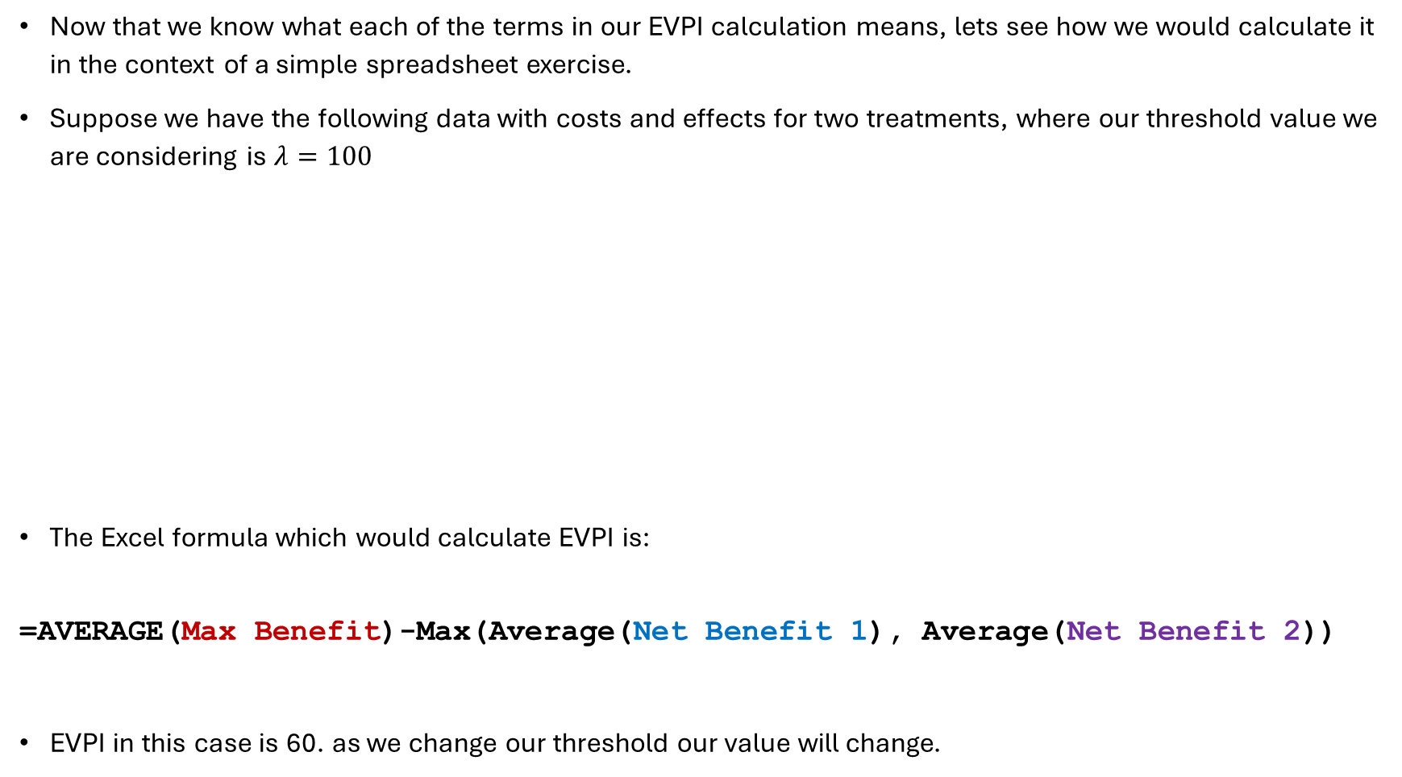
Computing EVPI in Excel
Now that we know what each of the terms in our EVPI calculation means, lets see how we would calculate it in the context of a simple spreadsheet exercise.
Suppose we have the following data with costs and effects for two treatments, where our threshold value we are considering is $λ=100$
The Excel formula which would calculate EVPI is:
=AVERAGE(Max Benefit)-Max(Average(Net Benefit 1), Average(Net Benefit 2))
EVPI in this case is 60. as we change our threshold our value will change.
Cost 1 | Cost 2 | Effect 1 | Effect 2 | Net Benefit 1 | Net Benefit 2 | Max Benefit
4 | 2 | 1 | 2 | 96 | 198 | 198
6 | 3 | 2 | 4 | 194 | 397 | 397
5 | 5 | 4 | 1 | 395 | 95 | 395
7 | 2 | 2 | 3 | 193 | 298 | 298
5 | 4 | 5 | 5 | 495 | 496 | 496

Slide 22
The Expected Value of Perfect Parameter Information
A Technical Overview

Slide 23
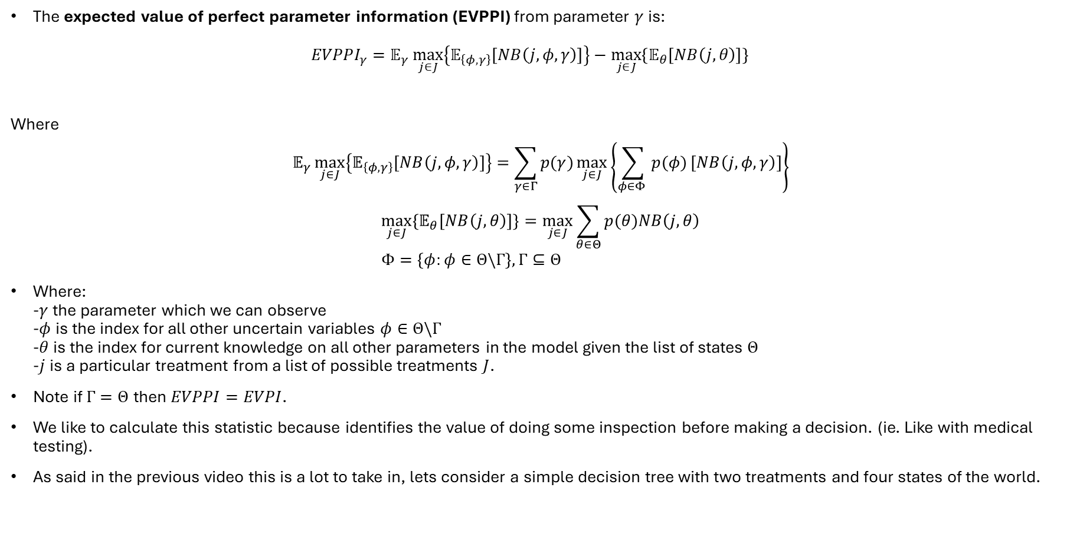
What is EVPPI?
The expected value of perfect parameter information (EVPPI) from parameter $γ$ is:
$EVPPI_{γ}=𝔼_{γ}\max_{j∈J}\left\{𝔼_{\left\{φ,γ\right\}}\left[NB\left(j,φ,γ\right)\right]\right\}−\max_{j∈J}\left\{𝔼_{θ}\left[NB\left(j,θ\right)\right]\right\}$
Where
$$𝔼_{γ}\max_{j∈J}\left\{𝔼_{\left\{φ,γ\right\}}\left[NB\left(j,φ,γ\right)\right]\right\}=\sum_{γ∈Γ}{p(γ)\max_{j∈J}\left\{\sum_{φ∈Φ }{p(φ)}\left[NB\left(j,φ,γ\right)\right]\right\}}$$
$$\max_{j∈J}\left\{𝔼_{θ}\left[NB\left(j,θ\right)\right]\right\}=\max_{j∈J}\sum_{θ∈Θ}{p(θ)NB\left(j,θ\right)} \\ Φ=\left\{φ:φ∈Θ\backslash Γ\right\},Γ⊆Θ$$
Where:
-$γ$ the parameter which we can observe
-$φ$ is the index for all other uncertain variables $φ∈Θ\backslash Γ$
-$θ$ is the index for current knowledge on all other parameters in the model given the list of states $Θ$
-$j$ is a particular treatment from a list of possible treatments $J$.
Note if $Γ=Θ$ then $EVPPI=EVPI$.
We like to calculate this statistic because identifies the value of doing some inspection before making a decision. (ie. Like with medical testing).
As said in the previous video this is a lot to take in, lets consider a simple decision tree with two treatments and four states of the world.

Slide 24
What is EVPPI?
The expected value of perfect parameter information (EVPPI) from parameter $γ$ is:
$EVPPI_{γ}=𝔼_{γ}\max_{j∈J}\left\{𝔼_{\left\{φ,γ\right\}}\left[NB\left(j,φ,γ\right)\right]\right\}−\max_{j∈J}\left\{𝔼_{θ}\left[NB\left(j,θ\right)\right]\right\}$
Where
$$𝔼_{γ}\max_{j∈J}\left\{𝔼_{\left\{φ,γ\right\}}\left[NB\left(j,φ,γ\right)\right]\right\}=\sum_{γ∈Γ}{p(γ)\max_{j∈J}\left\{\sum_{φ∈Φ }{p(φ)}\left[NB\left(j,φ,γ\right)\right]\right\}}$$
$$\max_{j∈J}\left\{𝔼_{θ}\left[NB\left(j,θ\right)\right]\right\}=\max_{j∈J}\sum_{θ∈Θ}{p(θ)NB\left(j,θ\right)} \\ Φ=\left\{φ:φ∈Θ\backslash Γ\right\},Γ⊆Θ$$
Where:
-$γ$ the parameter which we can observe
-$φ$ is the index for all other uncertain variables $φ∈Θ\backslash Γ$
-$θ$ is the index for current knowledge on all other parameters in the model given the list of states $Θ$
-$j$ is a particular treatment from a list of possible treatments $J$.
Note if $Γ=Θ$ then $EVPPI=EVPI$.
We like to calculate this statistic because identifies the value of doing some inspection before making a decision. (ie. Like with medical testing).
As said in the previous video this is a lot to take in, lets consider a simple decision tree with two treatments and four states of the world.
DON’T GET STRESSED OUT ABOUT THIS, LETS LOOK AT SOME PICTURES

Slide 25









Expected Value without Perfect Information
$$\max_{j∈J}\left\{𝔼_{θ}\left[NB\left(j,θ\right)\right]\right\}$$
Outcome 1
$$λE_{A1}−C_{A1}$$
State 1
Outcome 2
$$λE_{A2}−{C_{A}}_{2}$$
Treatment A
Outcome 3
$$λE_{A3}−C_{A3}$$
State 2
Outcome 4
$$λE_{A4}−C_{A4}$$
$$λE_{B1}−C_{B1}$$
Outcome 1
Treatment B
State 1
Outcome 2
$$λE_{B2}−C_{B2}$$
$$λE_{B3}−C_{B3}$$
State 2
Outcome 3
Outcome 4
$$λE_{B4}−C_{B4}$$

Slide 26






Expected Value without Perfect Information
$$\max_{j∈J}\left\{𝔼_{θ}\left[NB\left(j,θ\right)\right]\right\}$$
Outcome 1
$$λE_{A1}−C_{A1}$$
$$φ_{1}$$
State 1
Outcome 2
$$λE_{A2}−{C_{A}}_{2}$$
Treatment A
$$γ$$
Outcome 3
$$λE_{A3}−C_{A3}$$
State 2
$$φ_{2}$$
Outcome 4
$$λE_{A4}−C_{A4}$$
$$λE_{B1}−C_{B1}$$
Outcome 1
Treatment B
$$φ_{1}$$
State 1
Outcome 2
$$λE_{B2}−C_{B2}$$
$$γ$$
$$λE_{B3}−C_{B3}$$
State 2
Outcome 3
$$φ_{2}$$
Outcome 4
$$λE_{B4}−C_{B4}$$

Slide 27













Expected Value with Perfect Parameter Information
$$𝔼_{γ}\max_{j∈J}\left\{𝔼_{\left\{φ,γ\right\}}\left[NB\left(j,φ,γ\right)\right]\right\}=\sum_{γ∈Γ}{p(γ)\max_{j∈J}\left\{\sum_{φ∈Φ }{p(φ)}\left[NB\left(j,φ,γ\right)\right]\right\}}$$
Treatment A
Outcome 1
$$λE_{1A1}−C_{1A1}$$
$$φ_{1}$$
Outcome 2
$$λE_{1A2}−C_{1A2}$$
State 1
$$λE_{1B3}−C_{1B3}$$
Outcome 3
$$φ_{2}$$
Treatment B
Outcome 4
$$λE_{1B4}−C_{1B4}$$
$$γ$$
$$λE_{2A1}−C_{2A1}$$
Treatment A
Outcome 1
$$φ_{1}$$
State 2
Outcome 2
$$λE_{2A2}−C_{2A2}$$
Outcome 3
$$λE_{2B3}−C_{2B3}$$
$$φ_{2}$$
Outcome 4
Treatment B
$$λE_{2B4}−C_{2B4}$$

Slide 28
EVPI Curves

Slide 29
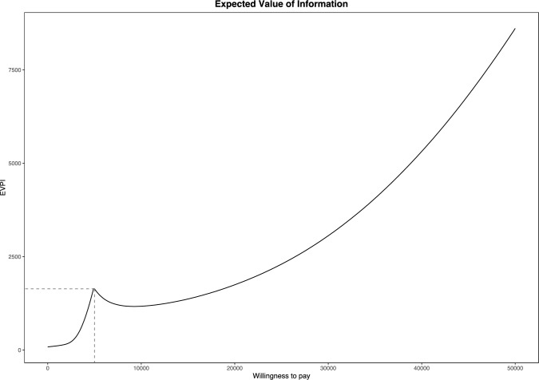
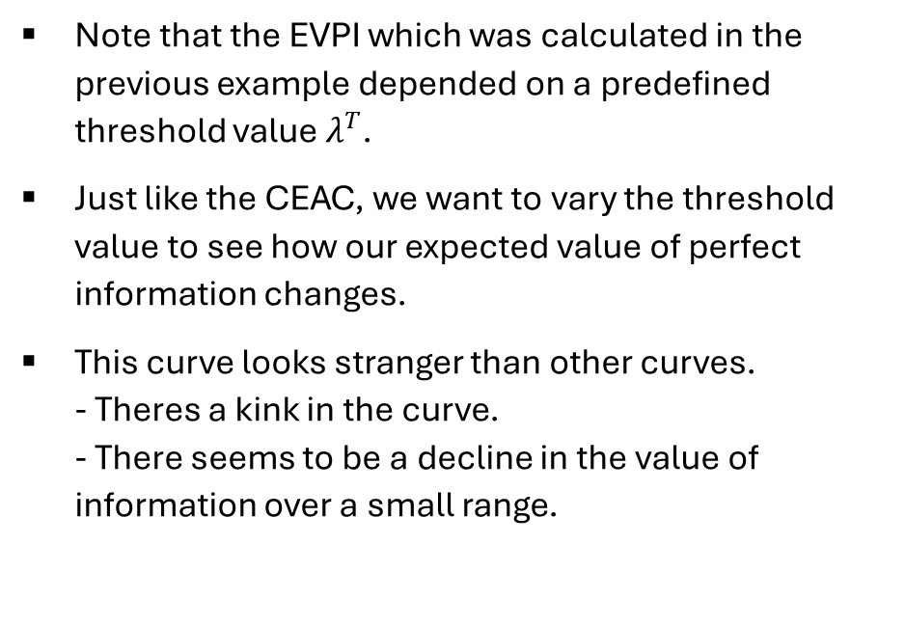
Graphically Representing EVPI
Note that the EVPI which was calculated in the previous example depended on a predefined threshold value $λ^{T}$.
Just like the CEAC, we want to vary the threshold value to see how our expected value of perfect information changes.
This curve looks stranger than other curves.
- Theres a kink in the curve.
- There seems to be a decline in the value of information over a small range.
Source: Nurchis, M. C., Radio, F. C., Salmasi, L., Heidar Alizadeh, A., Raspolini, G. M., Altamura, G., ... & Damiani, G. (2024). Bayesian cost-effectiveness analysis of Whole genome sequencing versus Whole exome sequencing in a pediatric population with suspected genetic disorders. The European Journal of Health Economics, 25(6), 999-1011.

Slide 30
Graphically Representing EVPI
To address each of these issues:
1. The kink in the curve occurs when there is a change in optimal treatment strategy (from treatment B to treatment A) in the EVwoPI part of the EVPI calculation.
2. The curvature in the EVPI curve is due to combining the EVPI results with our probability of cost effectiveness.
Source: Nurchis, M. C., Radio, F. C., Salmasi, L., Heidar Alizadeh, A., Raspolini, G. M., Altamura, G., ... & Damiani, G. (2024). Bayesian cost-effectiveness analysis of Whole genome sequencing versus Whole exome sequencing in a pediatric population with suspected genetic disorders. The European Journal of Health Economics, 25(6), 999-1011.

Slide 31
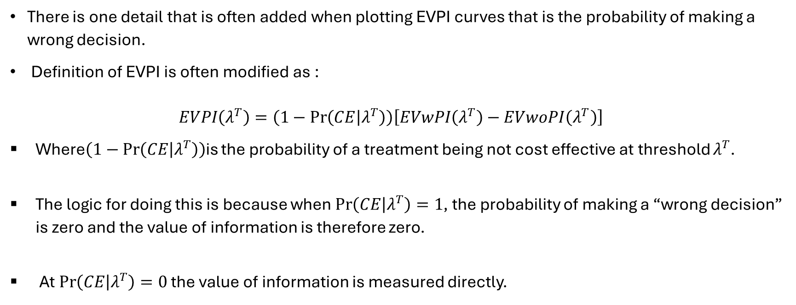
Combining EVPI and the Probability of cost effectiveness
There is one detail that is often added when plotting EVPI curves that is the probability of making a wrong decision.
Definition of EVPI is often modified as :
$EVPI\left(λ^{T}\right)=\left(1−\operatorname{Pr}\left(CE | λ^{T}\right)\right)\left[EVwPI\left(λ^{T}\right)−EVwoPI\left(λ^{T}\right)\right]$
Where$\left(1−\operatorname{Pr}\left(CE | λ^{T}\right)\right)$is the probability of a treatment being not cost effective at threshold $λ^{T}$.
The logic for doing this is because when $\operatorname{Pr}\left(CE | λ^{T}\right)=1$, the probability of making a “wrong decision” is zero and the value of information is therefore zero.
At $\operatorname{Pr}\left(CE | λ^{T}\right)=0$ the value of information is measured directly.

Slide 32
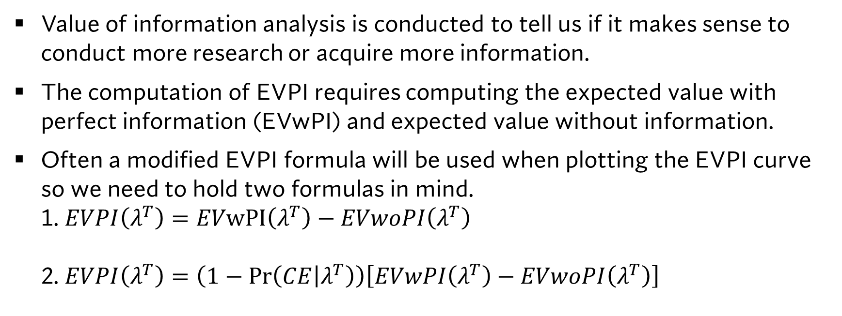
Some remarks on EVPI
Value of information analysis is conducted to tell us if it makes sense to conduct more research or acquire more information.
The computation of EVPI requires computing the expected value with perfect information (EVwPI) and expected value without information.
Often a modified EVPI formula will be used when plotting the EVPI curve so we need to hold two formulas in mind.
1. $EVPI\left(λ^{T}\right)=EVwPI\left(λ^{T}\right)−EVwoPI\left(λ^{T}\right)$
2. $EVPI\left(λ^{T}\right)=\left(1−\operatorname{Pr}\left(CE | λ^{T}\right)\right)\left[EVwPI\left(λ^{T}\right)−EVwoPI\left(λ^{T}\right)\right]$

Slide 33
A Model free approach to EVPI

Slide 34
The Value of Information as a “Model Free” Concept.
So far, we have been considering the value of information as defined by reducing model uncertainty.
This is done by figuring out what the best response is over every state of the world.
We can also think of the value of information as the value of the decision that minimizes loss.

Slide 35
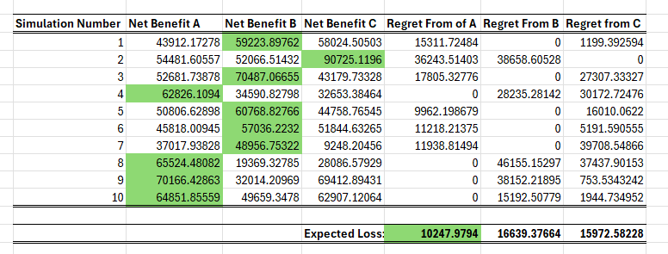

Slide 36
The Expected Value
of Perfect Information

Slide 37
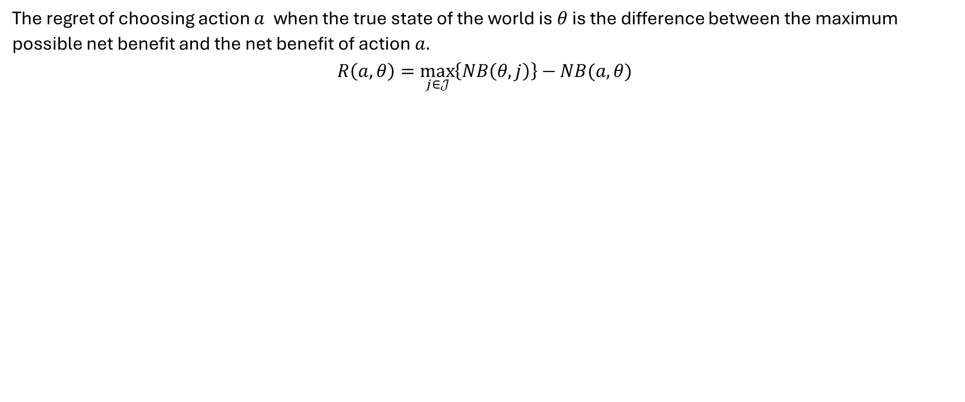
Why Minimal Expected Value of Regret is the Same as EVPI
The regret of choosing action $a$ when the true state of the world is $θ$ is the difference between the maximum possible net benefit and the net benefit of action $a.$
$$R\left(a,θ\right)=\max_{j∈𝒥}\left\{NB\left(θ,j\right)\right\}−NB(a,θ)$$

Slide 38
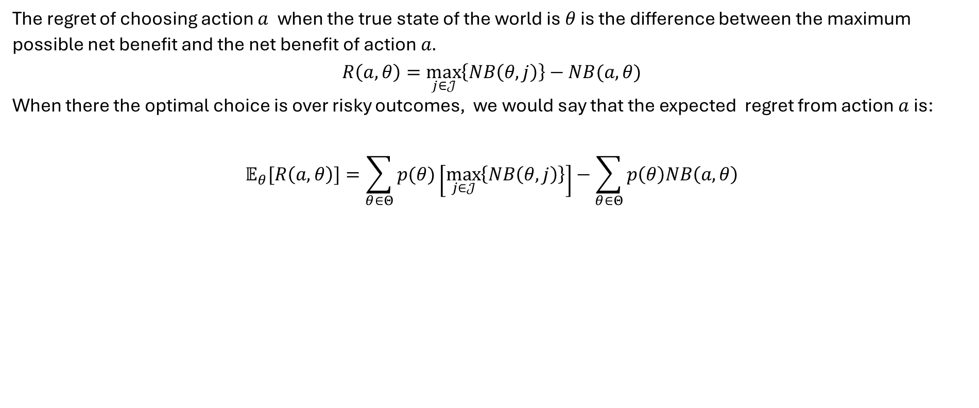
Why Minimal Expected Value of Regret is the Same as EVPI
The regret of choosing action $a$ when the true state of the world is $θ$ is the difference between the maximum possible net benefit and the net benefit of action $a.$
$$R\left(a,θ\right)=\max_{j∈𝒥}\left\{NB\left(θ,j\right)\right\}−NB(a,θ)$$
When there the optimal choice is over risky outcomes, we would say that the expected regret from action $a$ is:
$$𝔼_{θ}[R\left(a,θ\right)]=\sum_{θ∈Θ}{p(θ)}\left[\max_{j∈𝒥}\left\{NB\left(θ,j\right)\right\}\right]−\sum_{θ∈Θ}{p\left(θ\right)NB\left(a,θ\right)}$$

Slide 39
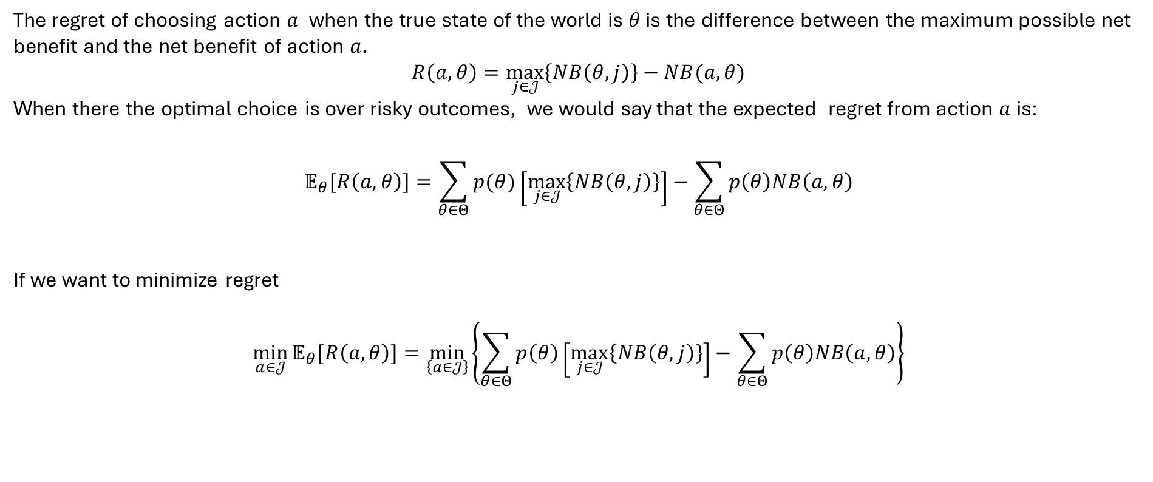
Why Minimal Expected Value of Regret is the Same as EVPI
The regret of choosing action $a$ when the true state of the world is $θ$ is the difference between the maximum possible net benefit and the net benefit of action $a.$
$$R\left(a,θ\right)=\max_{j∈𝒥}\left\{NB\left(θ,j\right)\right\}−NB(a,θ)$$
When there the optimal choice is over risky outcomes, we would say that the expected regret from action $a$ is:
$$𝔼_{θ}[R\left(a,θ\right)]=\sum_{θ∈Θ}{p(θ)}\left[\max_{j∈𝒥}\left\{NB\left(θ,j\right)\right\}\right]−\sum_{θ∈Θ}{p\left(θ\right)NB\left(a,θ\right)}$$
If we want to minimize regret
$$\min_{a∈𝒥}{𝔼_{θ}[R\left(a,θ\right)]}=\min_{\left\{a∈𝒥\right\}}\left\{\sum_{θ∈Θ}{p\left(θ\right)}\left[\max_{j∈𝒥}\left\{NB\left(θ,j\right)\right\}\right]−\sum_{θ∈Θ}{p\left(θ\right)NB\left(a,θ\right)}\right\}$$

Slide 40
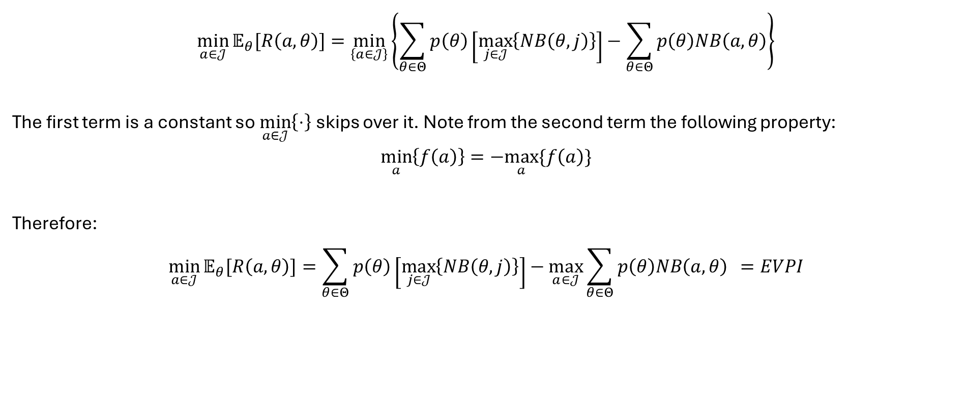
Why Minimal Expected Value of Regret is the Same as EVPI
$$\min_{a∈𝒥}{𝔼_{θ}[R\left(a,θ\right)]}=\min_{\left\{a∈𝒥\right\}}\left\{\sum_{θ∈Θ}{p\left(θ\right)}\left[\max_{j∈𝒥}\left\{NB\left(θ,j\right)\right\}\right]−\sum_{θ∈Θ}{p\left(θ\right)NB\left(a,θ\right)}\right\}$$
The first term is a constant so $\min_{a∈𝒥}\left\{⋅\right\}$skips over it. Note from the second term the following property:
$$\min_{a}\left\{f\left(a\right)\right\}=−\max_{a}\{f\left(a\right)\}$$
Therefore:
$$\min_{a∈𝒥}{𝔼_{θ}[R\left(a,θ\right)]}=\sum_{θ∈Θ}{p\left(θ\right)}\left[\max_{j∈𝒥}\left\{NB\left(θ,j\right)\right\}\right]−\max_{a∈𝒥}{\sum_{θ∈Θ}{p\left(θ\right)NB\left(a,θ\right)} }=EVPI$$

Slide 41
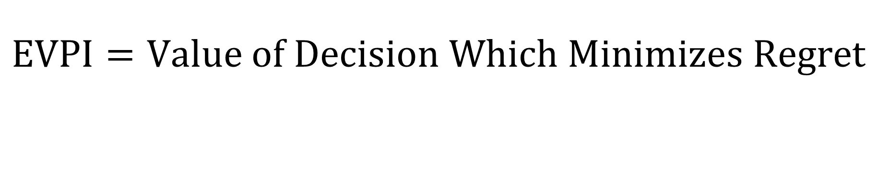
The Take Away
$$EVPI=Value of Decision Which Minimizes Regret$$
$$\min_{a∈𝒥}{𝔼_{θ}[R\left(a,θ\right)]}=\sum_{θ∈Θ}{p\left(θ\right)}\left[\max_{j∈𝒥}\left\{NB\left(θ,j\right)\right\}\right]−\max_{a∈𝒥}{\sum_{θ∈Θ}{p\left(θ\right)NB\left(a,θ\right)} }=EVPI$$

Slide 42
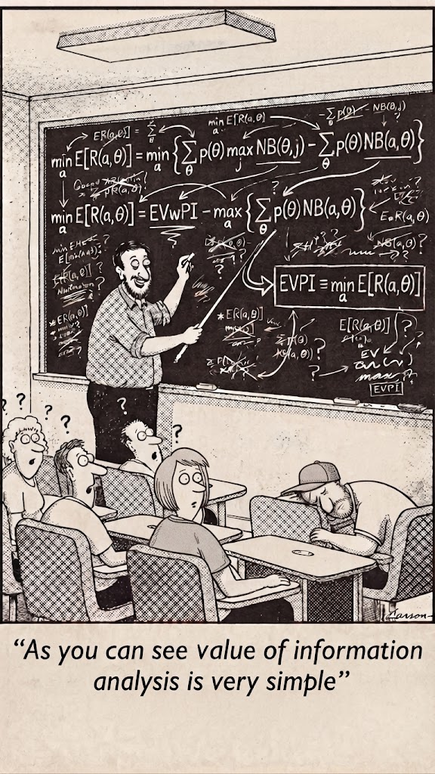
Concluding Remarks on Value of Information Analysis
Value of information analysis, from the classroom is complex.
However, behind the formulas exists a very simple, model free rule for defining the value of information.
If we can define “Regret” from a set of prospective treatments, we can define the expected value of perfect information from it without reference to EVwPI or EWwoPI.
There are no EVPI THRESHOLDS so if EVPI is larger than the cost of a test, the decision is to fund. (otherwise we do not fund.

